Slide 1
Real-Time Path Tracing Reconstruction
In DXR
Milestone 1
Team members:
Jiangping Xu
Gangzheng Tong
Tianming Xu

Slide 2
Our real-time path tracing pipeline
A basic path tracer produces 1 spp output image and populates necessary feature buffers(normal and world position) based on the 1 spp image
Pre-process the current frame to mix up with previous frames’ data
Apply Blockwise Multi-Order Feature Regression on the feature buffers
Post-process the frames’ data by accumulating the current frame’s information in
Apply the computed color to the pixel

Slide 3
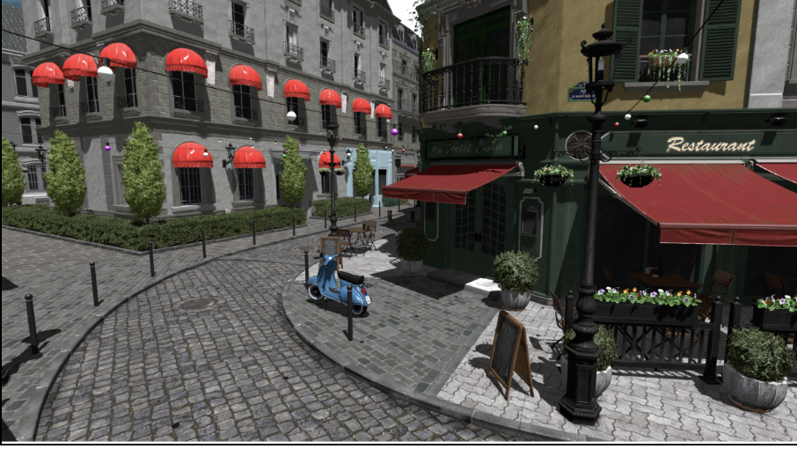
Falcor Library
https://developer.nvidia.com/falcor
An open-source real-time rendering framework designed specifically for rapid prototyping.
Find a tutorial to help us build DXR project based on Falcor.
Modifying the tutorial base codes to cut off many complex but unnecessary features.

Slide 4
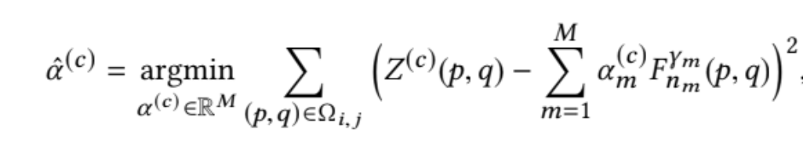
Overview of Blockwise Multi-Order Feature Regression(BMFR)
Accumulate each frame’s data to reuse in the future(Temporal Accumulation)
Both pre-process and post-process stages are doing this
Find the least square expression of the noisy path-traced input and the linear solutions of the feature buffers
The components of the feature buffers(constant, normal, world position and square of the world position)

Slide 5
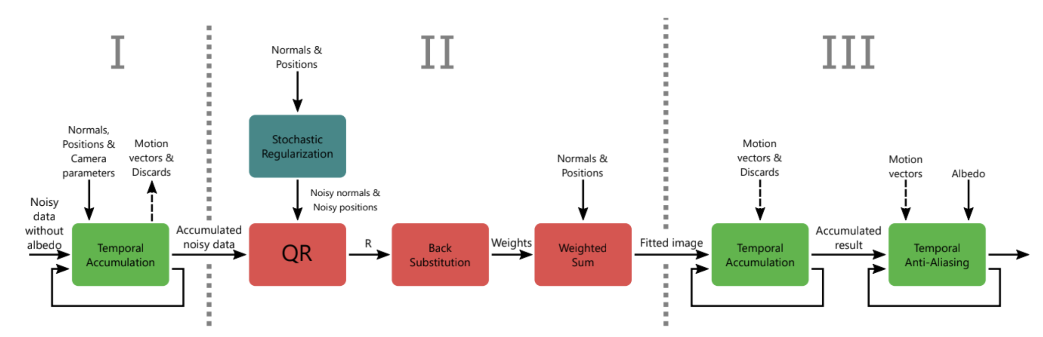
BMFR structural diagram
http://www.cs.tut.fi/~foi/papers/Koskela-TOG-2019-Blockwise_Multi_Order_Feature_Regression_for_Real_Time_Path_Tracing_Reconstruction.pdf

Slide 6
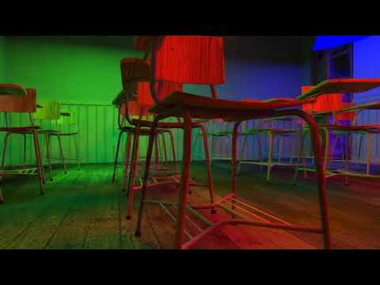
Original BMFR demo

Slide 7
Two possible improvements of BMFR
The degree of freedom of the original regression function is very limited. So in some scenarios the result might be compromised.
The paper adds random noise to each pixel within a block to eliminate the linear dependent among each others. But we found out that there is an alternative way to solve.

Slide 8
Future plan
Milestone 2
Finish the 1-spp path tracer and populate feature buffers
Set up the BMFR compute shader (input/output, QR factorization)
Understand temporal accumulation technique and try to set it up in D12
Milestone 3
Implement feature regression in compute shader
Implement the pre-processing and post-processing stage of BMFR
Apply back the final color and output the denoised image
Final presentation
Polish the project
Profile and measure the performance
Build better demo scene for presentation

Slide 9
Reference
http://www.cs.tut.fi/~foi/papers/Koskela-TOG-2019-Blockwise_Multi_Order_Feature_Regression_for_Real_Time_Path_Tracing_Reconstruction.pdf (BMFR original paper)
https://developer.nvidia.com/falcor (Falcor official set)
http://cwyman.org/code/dxrTutors/dxr_tutors.md.html (DXR using Falcor tutorial)
https://github.com/maZZZu/bmfr (BMFR sample codes)

